Slide 1
Computer Science
Counting theory
Samuel Lukas

Slide 2
Counting Principles & Problem 01
Additional & Multiplication principles
1. Computer science students can choose one tittle out of three available projects. Number of title in each project is 5, 4 and 7. How many title possibilities can a student choose ?
2. How many difference license plates are available if each plate contains a sequence of three letters followed by three digits without any constraint rule?
3. How many difference bits strings of length seven are there ?
4. There are three subject books, Mathematics, Computer and Literature. If there exist 5 mathematics books, 3 computer book and 2 literature books and one student want to borrow two books of different subjects. How many ways of borrowing book are there?

Slide 3
Problem 02
,
.
5. How many difference binary strings of length eight are there if it is started with digit 1 and ended by digit 00 ?
6. How many difference binary strings of length four are there if there is no at least two consecutive digits 1 ?
0
0
0
1
1
0
0
1
0
0
1
0
0
1
0
1
1
0

Slide 4
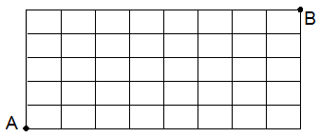
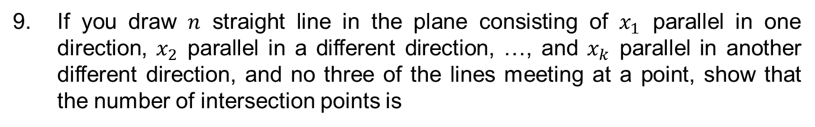
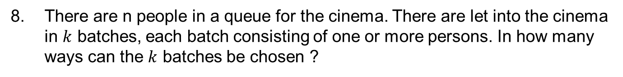
Problem 03
7. How many different shortest routes are there from A to B ?
8. There are n people in a queue for the cinema. There are let into the cinema in $k$ batches, each batch consisting of one or more persons. In how many ways can the $k$ batches be chosen ?
If you draw $n$ straight line in the plane consisting of $x_{1}$ parallel in one direction, $x_{2}$ parallel in a different direction, …, and $x_{k}$ parallel in another different direction, and no three of the lines meeting at a point, show that the number of intersection points is

Slide 5
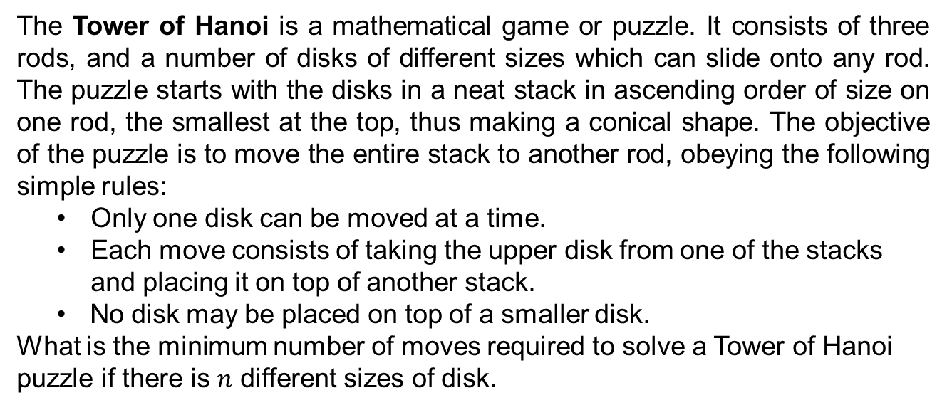
Recursive Problem 01
Fibonacci numbers : 0 , 1, 1, 2, 3, 5, 8, 13, …
Mathematically, it is written as $a_{n}=a_{n−2}+a_{n−1}$ $a_{0}=0, a_{1}=1$
Factorial numbers : 1, 2, 6, 24, … $a_{n}={(n)a}_{n−1}$ $a_{0}=1$
The Tower of Hanoi is a mathematical game or puzzle. It consists of three rods, and a number of disks of different sizes which can slide onto any rod. The puzzle starts with the disks in a neat stack in ascending order of size on one rod, the smallest at the top, thus making a conical shape. The objective of the puzzle is to move the entire stack to another rod, obeying the following simple rules:
Only one disk can be moved at a time.
Each move consists of taking the upper disk from one of the stacks and placing it on top of another stack.
No disk may be placed on top of a smaller disk.
What is the minimum number of moves required to solve a Tower of Hanoi puzzle if there is $n$ different sizes of disk.
2^{n} – 1

Slide 6





Recursive Problem 02
How many difference binary strings of length five are there if there is no at least two consecutive digits 0 ? Represent the problem for length of the string is $n$.
$$a_{1}=2 → \{ 0 , 1 \}$$
$$a_{2}=3 → \{ 01 , 10, 11 \}$$
$$a_{3}=5 → \{ 011 , 010, 101, 110, 111, \}$$
$$a_{5}=13$$
$$a_{4}=8 → \{ 0110 , 0111, 0101, 1010,1011, 1101, 1110, 1111\}$$
If number of binary strings of length $n−1$ that fit the constrains is $a_{n−1}$. It should be in the form of $x_{1}x_{2}x_{3}…x_{n−1}$
If $x_{n−1}=1 →adding x_{n}ε\left\{0,1\right\}$ to become $a_{n}.$ It is as much as $a_{n−1}$
If $x_{n−1}=0 →{adding x}_{n}ε\left\{1\right\}$ to become $a_{n}$. it is as much as $a_{n−2}$
$$∴a_{n}=a_{n−1}+a_{n−2}$$

Slide 7
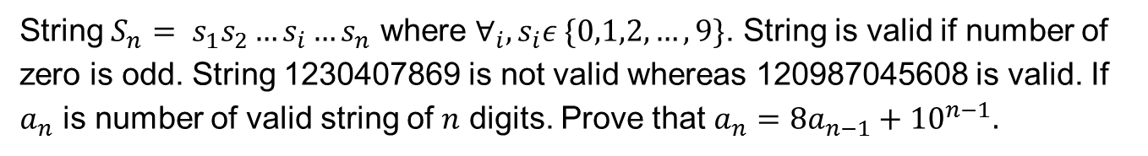
Recursive Problem 03
String $S_{n}= s_{1}s_{2}…s_{i}…s_{n}$ where ${∀_{i}, s}_{i}ε \{0,1,2,…,9\}$. String is valid if number of zero is odd. String 1230407869 is not valid whereas 120987045608 is valid. If $a_{n}$ is number of valid string of $n$ digits. Prove that $a_{n}=8a_{n−1}+{10}^{n−1}.$
$a_{n−1} i$s a valid string that consists on $n−1$ digits, $S_{n−1}= s_{1}s_{2}…s_{i}…s_{n−1}$ then number of non valid string of n-1 digits is ${{10}^{n−1}−a}_{n−1}$
$S_{n}= s_{1}s_{2}…s_{i}…s_{n−1}s_{n}$
If ($s_{n}=0)∧{(S}_{n} is valid) →$It is as much as non valid string $S_{n−1}$
If ($s_{n}≠0)∧(S_{n} is valis) →$It is as much as ${9a}_{n−1}$
Therefore, number of valid string
$$∴ S_{n}=9a_{n−1}+{(10}^{n−1}−a_{n−1})=8a_{n−1}+{10}^{n−1}$$

Slide 8
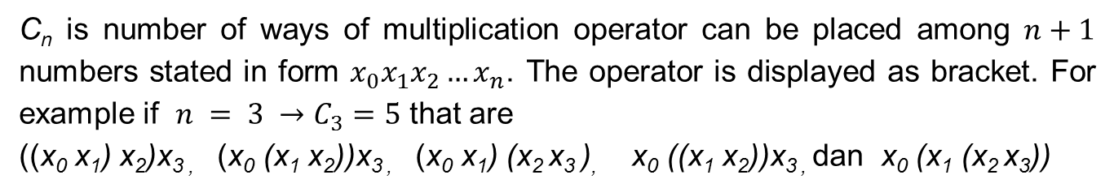
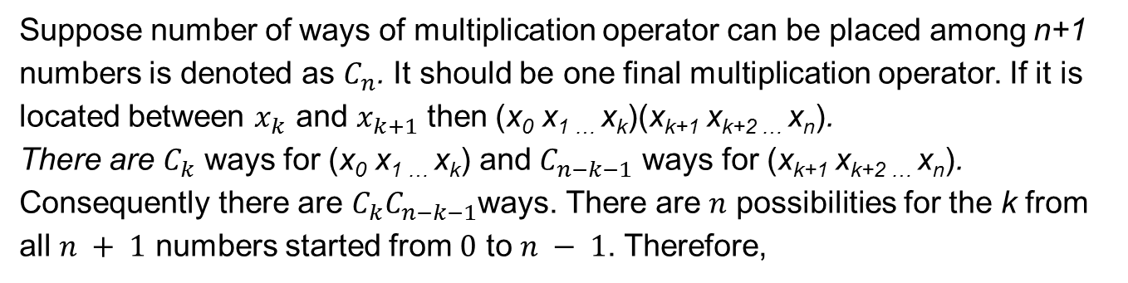
Recursive Problem 04
C_{n} is number of ways of multiplication operator can be placed among $n+1$ numbers stated in form $x_{0}x_{1}x_{2}…x_{n}$. The operator is displayed as bracket. For example if $n = 3 →C_{3}=5$ that are
((x₀ x₁) x₂)x_{3 ,} (x₀ (x₁ x₂))x_{3 ,} (x₀ x₁) (x₂ x₃ ), x₀ ((x₁ x₂))x_{3 ,} dan x₀ (x₁ (x₂ x₃))
Suppose number of ways of multiplication operator can be placed among n+1 numbers is denoted as $C_{n}$. It should be one final multiplication operator. If it is located between $x_{k}$ and $x_{k+1}$ then (x₀ x_{1 …} x_{k})(x_{k+1} x_{k+2 …} x_{n}).
There are $C_{k}$ ways for (x₀ x_{1 …} x_{k}) and $C_{n−k−1}$ ways for (x_{k+1} x_{k+2 …} x_{n}). Consequently there are $C_{k}C_{n−k−1}$ways. There are $n$ possibilities for the k from all $n + 1$ numbers started from $0$ to $n − 1$. Therefore,

Slide 9

Solving Recursive 01
$${1. a}_{n}=a_{n−1}+3 ∧ a_{1}=2 → a_{100}= ?$$
$$a_{n}=a_{n−1}+3$$
$$a_{n−1}=a_{n−2}+3 → a_{n}=a_{n−2}+2∙3$$
$$a_{n−2}=a_{n−3}+3 → a_{n}=a_{n−3}+3∙3$$
$$a_{n−3}=a_{n−4}+3 → a_{n}=a_{n−4}+4∙3$$
$$a_{n−1}=a_{n−(n−1)}+(n−1)∙3 → a_{n}=a_{1}+(n−1)∙3$$
$${∴a}_{n}=2+3n−3 → a_{n}=3n−1$$
$${∴a}_{100}=299$$

Slide 10

Solving Recursive 02
$${2. c}_{n}={2c}_{n−1}+1 ∧ c_{1}=1 → c_{100}= ?$$
$$c_{n}=2c_{n−1}+1$$
$$c_{n−1}=2c_{n−2}+1 → c_{n}={2(2c}_{n−2}+1)+1=2^{2}c_{n−2}+2+1$$
$$c_{n−2}={2c}_{n−3}+1 → c_{n}={2^{2} (2c}_{n−3}+1)+2∙1=2^{3}c_{n−3}+2^{2}+2+1$$
$$c_{n−3}={2c}_{n−4}+1 → c_{n}=2^{4}c_{n−4}+2^{3}+2^{2}+2+1$$
$$….$$
$$c_{n}=2^{n−1}c_{n−(n−1)}+2^{n−2}+2^{n−3}+…+2+1$$
$$c_{n}=2^{n−1}+2^{n−2}+2^{n−3}+…+2+1=2^{n}−1$$
$${∴c}_{100}=2^{100}−1$$

Slide 11




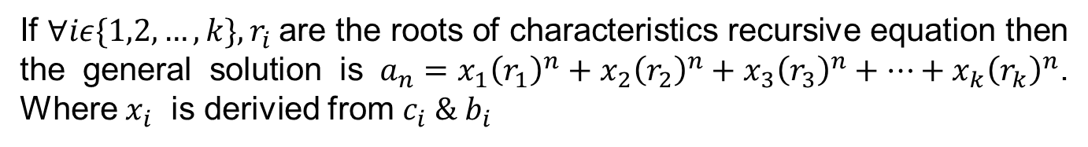

Basic Principles Solving Recursive
Linier Homogenous Recursive equation involves $k’s$ elements with real coefficients is stated :
$a_{n}=c_{1}a_{1}+c_{2}a_{2}+…+c_{k}a_{n−k}$, ${∀k, c}_{k}≠0$ with initial conditions $a_{0}=b_{0}, a_{1}=b_{1}, …, a_{k−1}=b_{k−1}$
$$c_{n}=2c_{n−1}+1$$
Linier & Non homogenous
$$a_{n}=a_{n−1}+a_{n−2}$$
Linier & homogenous
$$a_{n}=2a_{n−1}+2n$$
Linier & non-homogenous
$$a_{n}=2a_{n−1}a_{n−2}$$
Not-Linier & homogenous
$$f_{n}=2{n∙f}_{n−1}+3n$$
Not-Linier & non-homogenous
If ${∀iε\{1,2,…,k\}, r}_{i}$are the roots of characteristics recursive equation then the general solution is $a_{n}=x_{1}{\left(r_{1}\right)}^{n}+x_{2}{\left(r_{2}\right)}^{n}+x_{3}{\left(r_{3}\right)}^{n}+…+x_{k}{\left(r_{k}\right)}^{n}$. Where $x_{i}$ is derivied from $c_{i} \& b_{i}$

Slide 12
Recursive Problem 01
01. $a_{n}=5a_{n−1}−6a_{n−2}$ where $a_{0}=7 \& a_{1}=16$ find out $a_{10}= ?$
Characteristics of equation is $r^{n}=5r^{n−1}−6r^{n−2} → r^{2}=5r−6$
Roots of Characteristics equation are $r_{1}=2 \& r_{2}=3$
Then $a_{n}=b_{1}2^{n}+b_{2}3^{n}$
$$n=0 →a_{0}=b_{1}2^{0}+b_{2}3^{0}=7 → { b}_{1} +{ b}_{2 }=7$$
$$n=1 →a_{1}=b_{1}2^{1}+b_{2}3^{1}=16 → {2b}_{1}+{3b}_{2}=16$$
$$∴b_{1}=5 \&{ b}_{2}=2→a_{n}=5{∙2}^{n}+ 2∙3^{n}$$
$$∴a_{10}=5{∙2}^{10}+ 2∙3^{10}$$

Slide 13
Recursive Problem 02
02. $d_{n}=4{(d}_{n−1}−d_{n−2})$ where $d_{0}=d_{1}=1$ find out $d_{4}= ?$
Characteristics of equation is $r^{n}=4r^{n−1}−4r^{n−2} → r^{2}=4r−4$
Roots of Characteristics equation are $r_{1}=2 \& r_{2}=2$
Then $d_{n}={(b}_{1}+b_{2}n)∙2^{n}$
$$n=0 →d_{0}=b_{1}{∙2}^{0}=1 → { b}_{1} =1$$
$$n=1 →d_{1}={(b}_{1}+b_{2}∙1){∙2}^{1}=1 → {2+2b}_{2}=1 → b_{2}=−0.5$$
$$∴d_{n}=(1−0.5{∙n)∙2}^{n}$$
$$∴a_{4}=−16$$

Slide 14
Recursive Problem 03
03. $a_{n}=3a_{n−1}+2n$ where $a_{1}=4.5$ find out $a_{n}= ?$
Characteristics of equation is $r^{n}=3r^{n−1} →r=3$
General solution is $a_{n}=b{∙3}^{n}$
Particular solution is $a_{n}=p_{1}+p_{2}∙n$
Then ${p_{1}+p}_{2}∙n≡3{(p}_{1}+p_{2}∙(n−1))+2n$
$$∴p_{1}=3p_{1}−3p_{2} \& p_{2}={3p}_{2}+2 → { p_{2}=−1 \& p}_{1} =−1.5$$
$$∴a_{n}=b∙3^{n}−1.5−n$$
$$n=1→a_{1}=3b−0.5−1=4.5 →b=7/3$$
$$∴a_{n}=7{∙3}^{n−1}−0.5−n$$

Slide 15
Recursive Problem 04
04. $a_{n}=5a_{n−1}−6a_{n−2}+7^{n}$ where $a_{0}=\frac{69}{20} \&{ a}_{1}=\frac{343}{20}$ find out $a_{n}= ?$
Characteristics of equation is $r^{2}−5r+6=0 →r=\{2,3\}$
General solution is $a_{n}=b_{1}∙2^{n}+b_{2}{∙3}^{n}$
Particular solution is $a_{n}=p_{1}{∙7}^{n}$
Then $p_{1}{∙7}^{n}≡5{∙p}_{1}∙7^{n−1}−6∙p_{1}∙7^{n−2}+7^{n}$
$$∴49∙p_{1}=35p_{1}−6p_{1}+49 → p_{1}=\frac{49}{20}$$
$$∴a_{n}=b_{1}∙2^{n}+b_{2}∙3^{n}+\frac{49}{20}∙7^{n}$$
Finding $b_{1} \& b_{2}$ from initial value then
$$∴a_{n}=\frac{49}{20}{∙7}^{n}+3∙2^{n}−2∙3^{n}$$

